Slide 1
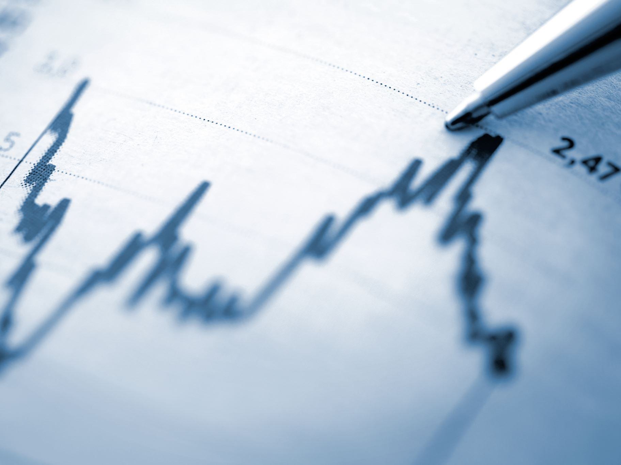
Stock Price Analysis Report
Full Project Report
Generated by ChatGPT

Slide 2
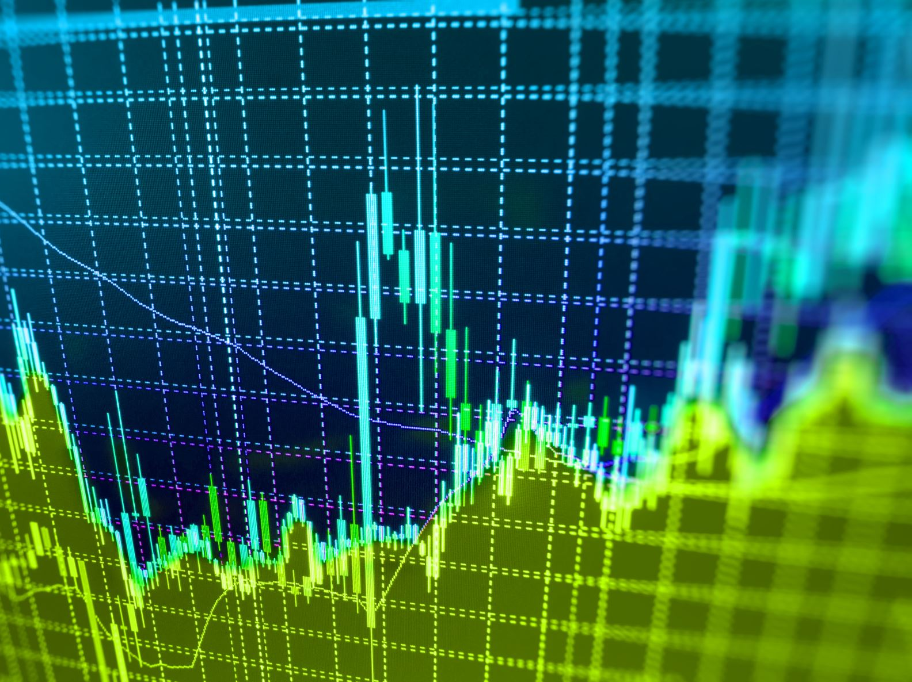
Project Overview
• Analyze realistic stock price dataset
• Calculate returns, volatility, and correlations
• Visualize AAPL and comparative stock performance
• Support financial insight and risk evaluation

Slide 3
Dataset Description
• CSV file: realistic_stock_prices.csv
• Contains historical adjusted close data
• Includes multiple tickers (e.g., AAPL, MSFT)
• Date indexed for time‑series analysis

Slide 4
Return & Volatility Analysis
• Daily returns computed using pct_change
• Annualized mean returns = daily_mean × 252
• Annualized volatility = std × sqrt(252)
• Helps assess expected performance and risk

Slide 5
Correlation Analysis
• Correlation matrix computed between stocks
• Measures relationship strength between assets
• Useful for portfolio diversification decisions

Slide 6
AAPL Price Trend
• AAPL closing price plotted over time
• Identifies market direction and major events
• Supports trend‑following and technical analysis

Slide 7
Multi‑Stock Price Comparison
• AAPL and MSFT plotted together
• Allows visual comparison of performance
• Shows divergence/convergence of stock movements

Slide 8
Conclusion
• Stock return & volatility provide risk profile
• Correlations show diversification opportunities
• Visualizations uncover price trends and patterns
• Framework supports deeper financial analysis

